Slide 1

ARM
PROCESSOR ARCHITECTURES

Slide 2
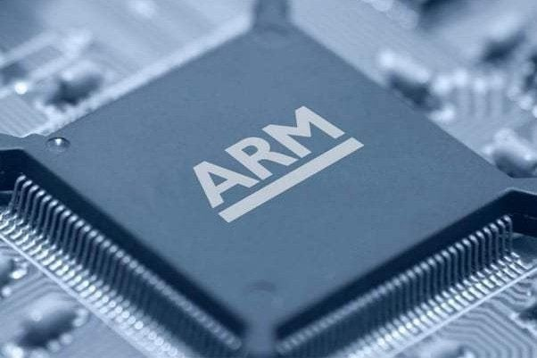

Slide 3
ARM
ARM processors are extensively used in consumer electronic devices such as smartphones, tablets, multimedia players and other mobile devices, such as wearables. Because of their reduced instruction set, they require fewer transistors, which enables a smaller die size for the integrated circuitry (IC). ARM is a family of instruction set architectures used in making computer processors developed by ARM Holdings.
It is based on the reduced instruction set computing architecture which is commonly called as RISC.
In 2010, ARM Holdings, reported shipments of approximately 6100 million ARM-based processors to manufacturers of chips based on ARM architectures, representing 35 per cent of digital TVs and set-top boxes, 95 per cent of smartphones and 10 per cent of mobile computers. As of 2014, ARM is the most widely used 32-bit instruction set architecture in terms of quantity produced.
The ARM architecture was originally developed by Acorn Computers in the 1980s.

Slide 4
ARM processor features include:
Load/store architecture.
An orthogonal instruction set.
Mostly single-cycle execution.
Enhanced power-saving design.
64 and 32-bit execution states for scalable high performance.

Slide 5
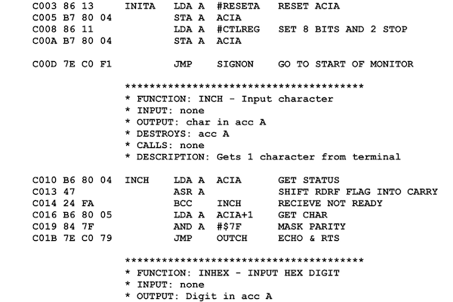
ARM ASSEBLY CODE

Slide 6
WHAT FUTURE PLANS
The head-to-head competition between the vendors is increasing as ARM is finding its way into full size notebooks. Microsoft, for example, offers ARM-based versions of Surface computers. The cleaner code base of Windows RT versus x86 versions may be also partially responsible -- Windows RT is more streamlined because it doesn’t have to support a number of legacy hardwares.
ARM is also moving into the server market, a move that represents a large change in direction and a hedging of bets on performance-per-watt over raw compute power. AMD offers 8-core versions of ARM processors for its Opteron series of processors.

